Slide 1

SRBIJA
MEDIJSKE SLIKE I PRILIKE
To replace the image: Copy desired new image, select existing image below, delete, select placeholder, paste & “send to back”
1
© 2015 Ipsos.

Slide 2

Estimated mid year population
OCENA
-38.000 yearly
-35.000 yearly
Source: State Statistical Office
2

Slide 3
Basic contingents of the population
Source: State Statistical Office
3

Slide 4
Print, radio & TV stations in Serbia 2016
ELECTRONIC | RADIO | TV
LOCAL | 290 | 82
REGIONAL | 25+ | 27+
PROVINCES’ | 1 | 0
NATIONAL | 8 | 5
TOTAL TERRESTRIAL TRANSIMITION | 320+ | 5
CABLE TV |  | 100+
TOTAL TERRESTRIAL & CABLE | 320+ | 250+
PRINT | PRINT
DAILY | ≈13
WEEKLY | ≈18
BIWEEKLY | ≈8
MONTHLY&OTHER | ≈84
TOTAL | 170+
WEB PORTALS | NEWS
NEWS WEB PORTALS | 20+
Notes:
4

Slide 5
Advertising media market

Slide 6

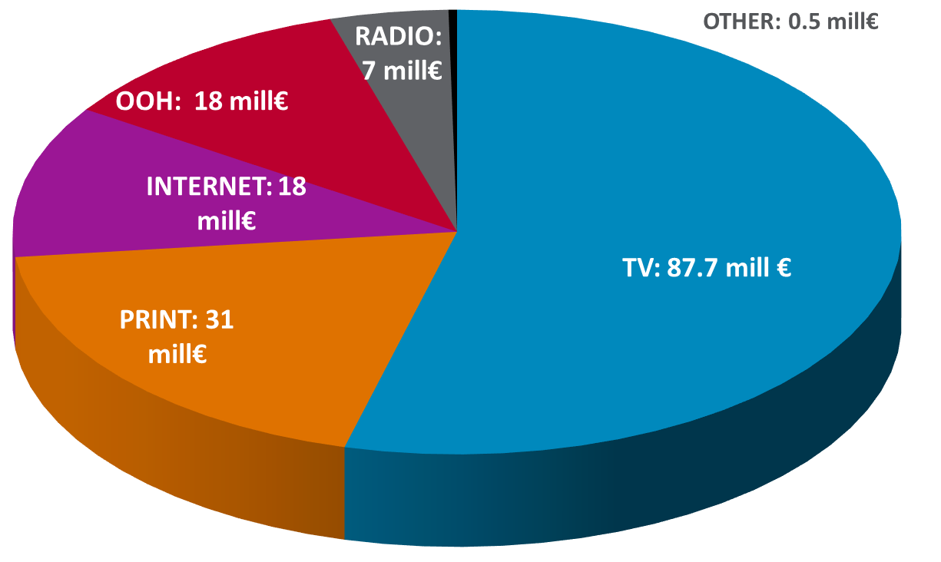
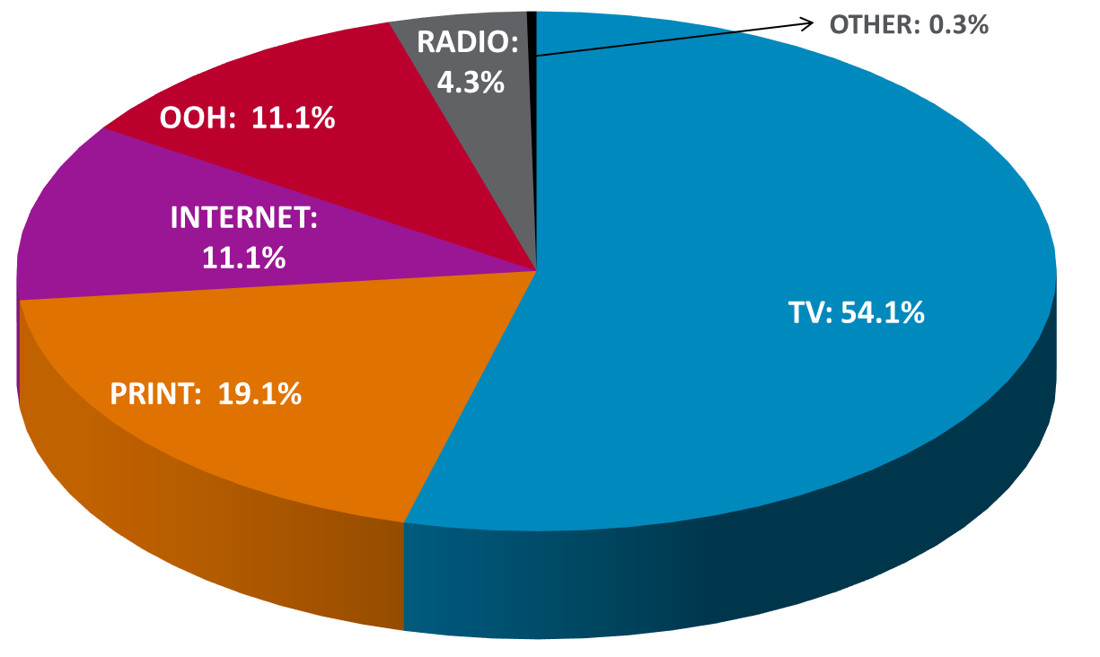
Estimated value of ATL media budgets spent on (2015)
Source: Nielsen Audience Measurment - Values refers to the net budgets of ATL budgets, VAT sexcluded, no production costs and AVB
6
Notes:
6

Slide 7
Estimated value of ATL media budgets spent on mass media 2001-2015.
SLIGHT INCREASE 156 mil € 2014 TO 162 mil € 2015 (+4%)
+18%
+52%
+9%
-2%
0%
-22%
+1%
+4%
-10%
+21%
+21%
+18%
+19%
+63%
Source: Nielsen Audience Measurment - Values refers to the net budgets of ATL budgets, VAT sexcluded, no production costs and AVB
7
Notes:
7

Slide 8
estimated NET VALUE OF tv MARKET
Serbia 2004 – 2015, in millions of Euro
Source: Nielsen Audience Measurment - Values refers to the net budgets of ATL budgets, VAT sexcluded, no production costs and AVB

Slide 9
Trend of estimated media segmentation in %
Split by media; Serbia 2005 - 2015
Source: Nielsen Audience Measurment - Values refers to the net budgets of ATL budgets, VAT sexcluded, no production costs and AVB

Slide 10
Audience

Slide 11
2016 | WEEKLY COVERAGE (RCH)
TV | 6,900,000
RADIO | 3,400,670
INTERNET | 4,000,000
PRINT | 3,700,000
Mil
11
Notes:
11

Slide 12
TV

Slide 13
Average daily audience (% of total population 4+)
2016 YTD – 72.2%
Notes:
13

Slide 14
SHR % - Total participation of national TV stations in TV auditorium
(Total population 4+)
2016 YTD – 61.6%
Notes:
14

Slide 15
Print

Slide 16
Average readership (% of total population 12+)
Notes:
16

Slide 17
Readership 2012.-2016. (% of total population 12+)
2012.
2013.
2014.
2015.
17
Notes:
17

Slide 18
Internet

Slide 19
Internet usage (% of total population 15-64)
Source: ISM Research

Slide 20
Radio

Slide 21
Average weekly audience (% of total population 12+)
2016 YTD – 52.9%
Source: ISM Radio SW
21
21
Notes:
21

Slide 22
overview

Slide 23
Total audience by media
Source: Nielsen Audience Measurement, PrintAdEx & BRANDPuls & Radio SW

Slide 24
Average daily media consumption in minutes
Source: Nielsen Audience Measurement, PrintAdEx & BRANDPuls & Radio SW

Slide 25
trendovi

Slide 26









5.6 hours spent online per day by the average American (vs. 4.6 hours watching TV) – an increase of 107% since 2010
YOUR CUSTOMERS HAVE MORE MEDIA CHOICES THAN EVER BEFORE
400 hours of content uploaded to YouTube every minute
Growth is fragmented across new platforms fuelled by mobile devices and multi-screening
Sources: eMarketer / http://www.reelseo.com/vidcon-2015-strategic-insights-tactical-advice/

Slide 27

87% of Facebook accounts are accessed on mobile
YOUR CUSTOMERS ARE LIVING IN AN INCREASINGLY MOBILE FIRST WORLD
51% of time spent with digital media in the US is on mobile
Emerging markets have skipped desktop. Most internet traffic is mobile in Nigeria (76%), India (65%), Indonesia and South Africa (both 57%).
Sources: Social Bakers / eMarketer / Statcounter

Slide 28


25% of smartphone owners have downloaded ad blocking apps
YOUR CUSTOMERS ARE IMPATIENT.
AD AVOIDANCE IS RISING.
GETTING ATTENTION IS MORE IMPORTANT THAN EVER BEFORE
80% of YouTube Trueview ads are skipped
2 second delay in an e-commerce transaction causes a 25% increase in shopping cart abandonment
Sources: Tune Ad Blocking Report 2016 / eMarketer / Adventures in Retail: The other line is faster, Brand Perfect, November 2012

Slide 29
It is harder for advertising to get attention
Ad recognition, click rates, open rates, etc, are on the decline in most countries, across most media. → The pressure for great creative quality is increasing!
Aided Ad Recognition for TV Ads
after 750 Cumulative TRPs
(Canadian Database)
Sources: Ipsos Connect Tracking data-base from Canada. Many countries are similar

Slide 30
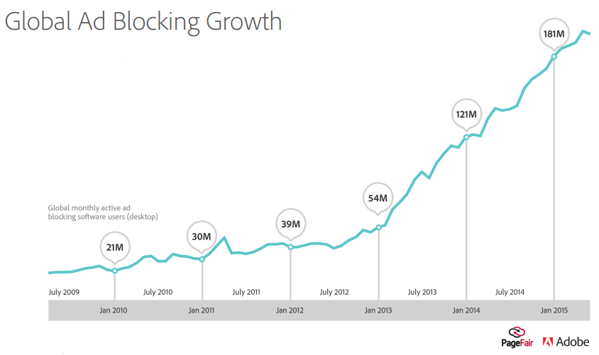
It is harder for advertising to get attention
AD BLOCKING HAS GROWN RAPIDLY SINCE 2013
– NOW ESTIMATED 25% OF SMARTPHONE USERS HAVE INSTALLED AD BLOCKING APPS

Slide 31
Comparative Summary: Recall X Impact
(Averaged across many different Campaigns, for each touchpoint when present in the mix)
Source: ASI:Live 360 - Global database

Slide 32

Think “Dis-IMC”
Touchpoints need to be selected for how each touchpoint best plays its role.
It is about the orchestration of objectives, targets and roles of the touchpoints
Desire
Trial
Volume
Website
WoM
News
WoM
Special
packaging
News
Special
packaging
In-store
displays
Special
packaging
Special
packaging
In-store displays
WoM
Billboard
TV ad
In-store displays
Metro Ads
TV ad (prompted)
In-store
displays
WoM
TV ad
Case: CPG Category, North America

Slide 33
Think 300%
Consumers will likely experience many different touchpoint.
Multi-channel plans are proven to have a greater impact than over-spending in a few channels
Number of Touchpoints Experienced
Source: CPG Case Example, U.S.
5 + Touchpoints
4 Touchpoints
3 Touchpoints
2 Touchpoints
0 Touchpoints
1 Touchpoint
It is not Television VERSUS Digital.
It is TV + Digital + Point-of-Purchase.

Slide 34

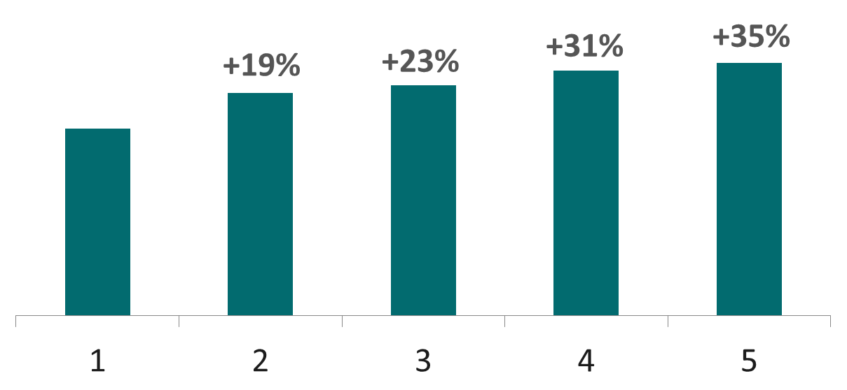
ROI of a campaign increases with number of channels used
Incremental ROI of Additional Media Channels
*Media channels: TV, Print, Radio, Display, Paid Search, Online Video, PR, Out-of-Home & Cinema
Source: How Advertising Works’ ARF, March 2016 - Analytic Partners, 2016; Analysis based on over 3,200 campaigns from 2010-2015

Slide 35
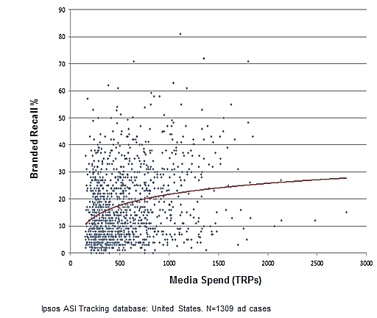
It’s All About Strong Creative
Merely7%
75%
38%
Of ad awareness is explained by media weight.
Ad recall cannot be ‘bought’ with a large media budget.
Of variance in ad awareness is due to creative quality.
Ad recall is ‘earned’ by producing creative that resonates and motivates.
Screening + optimizing can increase the effectiveness of the final ad by an average of 38%.
Other factors
Creative
Source: Ipsos meta-analysis of several hundred matched cases of ads tested and others screened-and-optimized via copy tested in the US
Source: Ipsos meta-analysis of over 1300 ads tracked in the US
Ensure you only use above-average creative for good ROI.
--Do you have the right ad development process?

Slide 36
Bad creative very rarely wears-in.
Ad Recall
%
50
40
30
Claimed Ad Recall
20
17
14
10
Proven Correct Content Recall
0
0
0
200
Creative #1
Creative #2
Adults
150
260
100
420
248
242
184
454
259
234
226
190
177
50
192
4
218
TRP'S
235
0
weeks
Don’t wait long to adjust to problems. Cumulative media rarely off-sets weak creative. “Launch, learn, adapt”

Slide 37
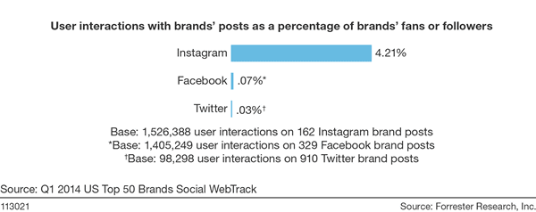

People do not really talk about brands nor engage with Brand Posts in social networks

Slide 38

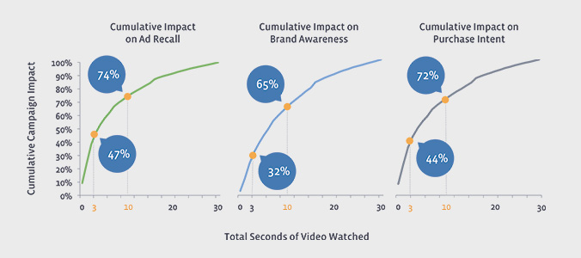
After 10 seconds, the brand impact from fb video diminishes
FACEBOOK
Source: The Value of Video for Brands - Facebook
Most impact is delivered in the first 10 seconds – long ads aren’t necessary in Fb.
… Leverage ‘visual Imagery’ to earn attention.

Slide 39
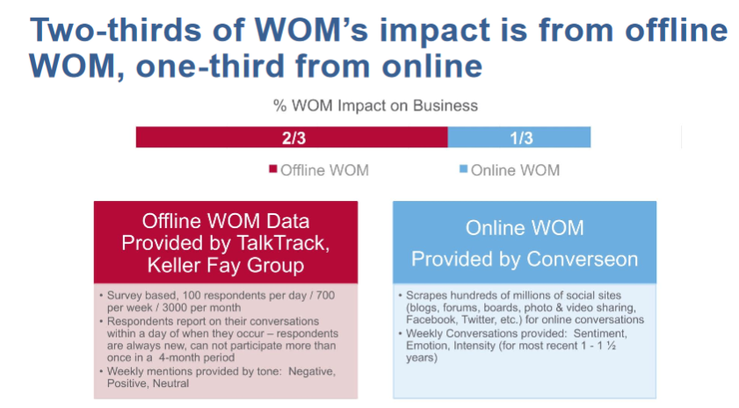
The research was undertaken by the top modeling firm Analytic Partners, under the supervision of Sequent Partners, both highly respected independent research companies. Participating in the study were major brands that contributed their confidential business data and funding, including AT&T, Discovery Communications, Intuit, Pepsico, and Weight Watchers. Funding also came from agencies Brains on Fire, House Party, Ogilvy and Zocalo Group

Slide 40
Media exposure does not equal recall
Better Ad Recall
Claimed Recall
54%
40%
34%
29%
Proven Recall
22%
15%
More exposure, but less recall!
Watch more TV
18-34 yrs
35-49 yrs
50+ yrs
Efficient media planning is not based on media consumption data
Source: Ipsos ASI:Live database

Slide 41
Furthermore, ‘Attention’ varies by type of show
The likelihood to watch one particular show (versus switching or doing something else) differs by the type of show being watched...
Soaps
Reality TV
News
Investigative
Comedy
Movie
TV Magazine/Entertainment
Sports
History/Documentary
Music
Source: Ipsos “Quality Rating Point Study”
‘Receptivity’ is a key concept when buying media. Focus on the quality of the exposures in terms of greater receptivity for each OTS

Slide 42
Brand Performance is #1. Make sure quality/service is very good
Think holistic marcomms; integrated, and with consistency:
  Think 300% rather than 100%: TV + Digital + Store
  “Dis-IMC”; Use TPs differently, relevantly
  Digital (and particularly ‘Search’) focused on sales activation
Only air strong creative. Do you have a strong ad development process?
            Receptivity + Engagement > Exposures
            Reach > Frequency
            Recency (Coverage) > Concentrated SoV (minimize the ‘decay’)
            React + Refresh quickly
            Word-of-Mouth: Be relevant, but do not depend on WoM as your goal

Slide 43
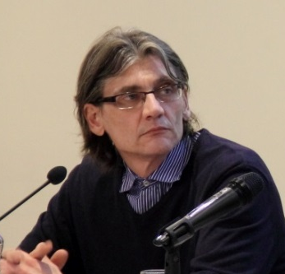
Contacts
Dejan Radosavljević
Research Director
dejan.radosavljević@ipsos.com
+381 60 0900 418

